Slide 1

WEEK 1 AGENDA
PHASE 1: INSPIRE
WELCOME & ATTENDANCE (5 MIN)
INTRODUCTIONS & ICE BREAKERS (45 MIN)
ADMINISTRATION & HOUSEKEEPING (15 MIN)
OVERVIEW OF COMPANY PROGRAM (15 MIN)
BRAINSTORMING AND PITCHING ACTIVITY (60 MIN)
PRODUCT & SERVICE RESEARCH ASSIGNMENT (15 MIN)
ENTREPRENUERIAL RESILIENCY MODULES (10 MIN)
QUESTIONS & WRAP UP (10 MIN)

Slide 2

Admin & housekeeping
Review Student Welcome package or Student Orientation
Remind your parents to complete the Parent Consent Form
Create an account on JA Campus (visit https://www.jacampus.org to sign up)
Housekeeping rules
Contacting advisors
Other
Notes:
Administration and housekeeping (15 min)
In Charters with pre-registration, students will likely have received a welcome package from the local Charter.
If pre-registration was not done or you have new students, inform them that the JA Canada Welcome Package is available in the student section on the JA Campus.
Ensure that all students are on the attendance list with a valid email address to allow the Program Manager to contact them after the session with information regarding the JA Campus.
Let students know that they are required to have their parents sign the Parent and Media Consent Form to participate in the program. Connect with your local Charter on their preferred process (online or paper) for collecting the form.
Review any housekeeping rules for your meetings - this may include important notes regarding your meeting space (rules on bringing food/drinks, where the restrooms are, restricted areas, etc.) and if you’re meeting virtually, how chat and other functions work within the virtual meeting platform you are using, etc.
You will determine as a team your group norms in your next meeting but for now set the rules and expectations for your first meeting to ensure it goes smoothly.
You may also want to establish and clarify contact methods and hours for advisors: let your students know the preferred way for students to communicate with you (i.e. email address, phone number) as well as the best days and times to reach you. You may want to set expectations for students up front as to your response time (i.e. if they email you that evening, they should wait 1 to 2 business days before following up for a response, etc.)
Share any other rules or guidelines that will help set students and yourself up for success.

Slide 3

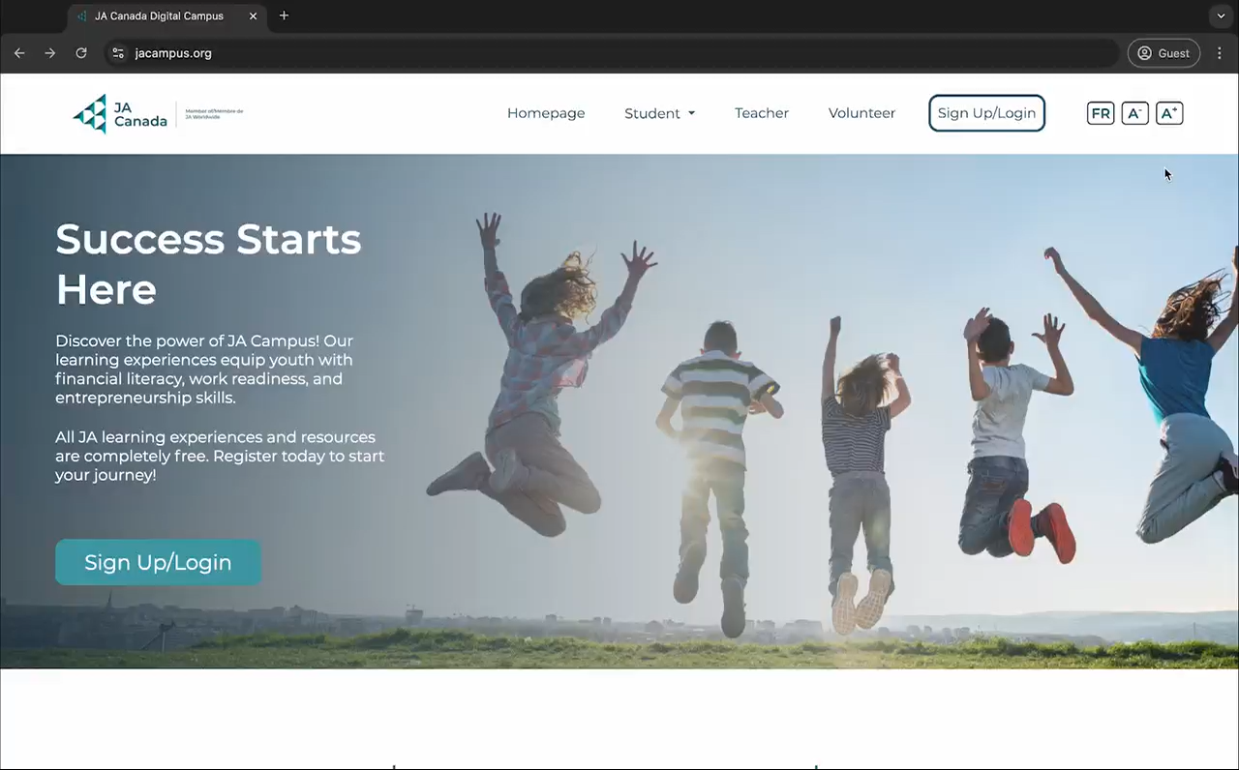
JA Campus
Sign up on JA Campus
Notes:
Administration and housekeeping (15 min)
Explain that the JA Campus will become an important tool for students over the program.
Encourage them to go online and create an account.
They will be able to access important information and documents about the program.
Watch the video for how to set up a JA ID account.
Once they follow the steps to create an account, they can find the Start Exploring section, look for the Company Program Student Materials tile and select “Go to program”

Slide 4

JA Company Code of Ethics
WHAT ARE BUSINESS ETHICS?
The ability to make decisions that are not attached to financial gain alone.
Notes:
Overview of Company Program (15 min)
Explain that the JA Company Code of Ethics determines how JA Executive and Staff members will guide their decision making.

Slide 5

JA Company Code of Ethics
WHAT IS A CODE OF ETHICS?
A code of ethics and professional conduct outlines the ethical principles that govern decisions and behavior at a company or organization:
How employees should behave
Following the law
How to report unethical conduct
Being environmentally conscious
Sourcing ethically made supplies
How to be inclusive and caring to all
Notes:
Overview of Company Program (15 min)
Define what a code of ethics is and what it helps to do.

Slide 6

JA Company Code of Ethics
TEST OF DISCLOSURE
A quick basic test to see if a decision is ethical or not.
Every JA Company should use this test to guide decisions.
Ask: “How would we feel if everyone knew about the decision we are making?”
Notes:
Overview of Company Program (15 min)
Define “test of disclosure” and explain that students can use this test during their Company Program experience by asking themselves “How would we feel if everyone knew about the decision we are making?”

Slide 7
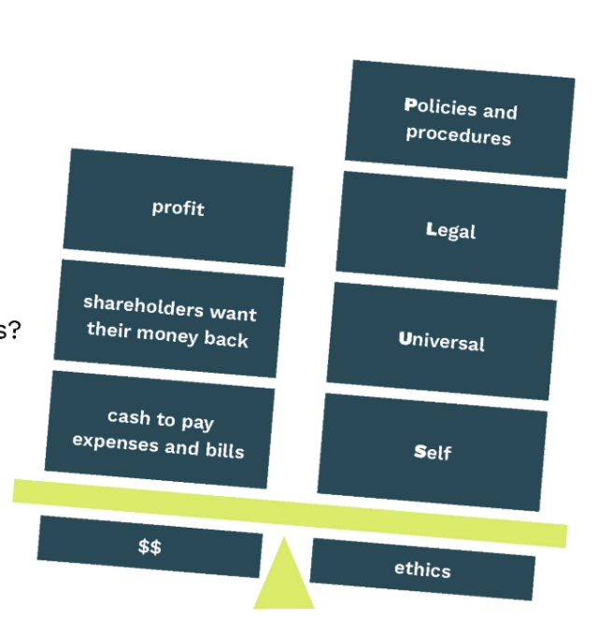
JA Company Code of Ethics
HOW PLUS MODEL CAN GUIDE DECISION MAKING
P = Policies and Procedures
Does this align with company polices?
L = Legal
Does this decision violate any laws or regulations?
U = Universal
Is this decision in line with core values and company culture? How does it relate to organizational values?
S = Self
Does it meet my standards of fairness and honesty?
Notes:
Overview of Company Program (15 min)
Review each letter of the PLUS acronym.
Explain that students can use this model and the guiding questions to help them make ethical business decisions.
Share that sometimes unethical decisions are made when companies are focused on finances or profits, rather than what is the right thing to do.

Slide 8

JA Company Code of Ethics
EXAMPLE: TIM HORTONS CODE OF ETHICS
“It means being fair and ethical in our dealings with employees, restaurant owners, and customers. It means dealing with others with respect and fairness.”
Tim Hortons believes that the principles of respect and fairness extend to our relationships with our business partners and suppliers
Notes:
Overview of Company Program (15 min)
Use the example of Tim Hortons to illustrate what their code of ethics means to them.

Slide 9


OVERVIEW OF COMPANY PROGRAM

Slide 10
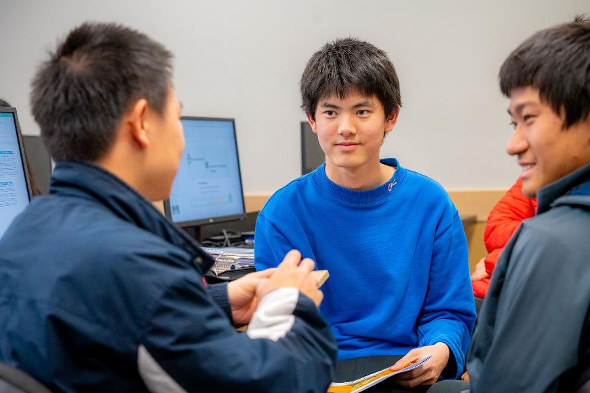

Expectations
During your Company Program experience, you are expected to:
Show up each week (80% attendance is required)
Actively participate and contribute to the best of your ability
Be mindful of ethics as related to JA Company Program
Take it seriously
Act responsibly
Have fun
Be creative
Notes:
Overview of Company Program (15 min)

Slide 11

Program Benefits
AWARDS AND SCHOLARSHIPS
Through JA Canada, you will receive information about various awards and scholarships. Your local Charter may also have awards and scholarships available.
Notes:
Overview of Company Program (15 min)
Highlight that these scholarships can help them as they continue to pursue their future careers

Slide 12

Program Benefits
NATIONAL AND GLOBAL OPPORTUNITIES
JA Canada hosts an annual virtual Company of the Year competition which may lead to opportunities for students to participate in other National, or even global JA events with other Company Program alumni.
Notes:
Overview of Company Program (15 min)
More details will be available from your local Charter about these opportunities.

Slide 13

Product Inspiration
INFINITEA TEA-SHIRTS
JA CENTRAL ONTARIO
This business leveraged great social media campaigns including the “tea”-shirt of the day.
Notes:
Overview of Company Program (15 min)
Review the product inspiration slides to highlight successful companies from previous JA Company Program students
As you review the slides, encourage students to take inspiration from these ideas

Slide 14

Product Inspiration
PLASTO POTATO JEWELLERY
JA JAMAICA
Students from this Jamaican JA Company figured out the chemistry needed to turn potatoes into plastic and then used that plastic to create jewellery.
Notes:
Overview of Company Program (15 min)
Review the product inspiration slides to highlight successful companies from previous JA Company Program students
As you review the slides, encourage students to take inspiration from these ideas

Slide 15
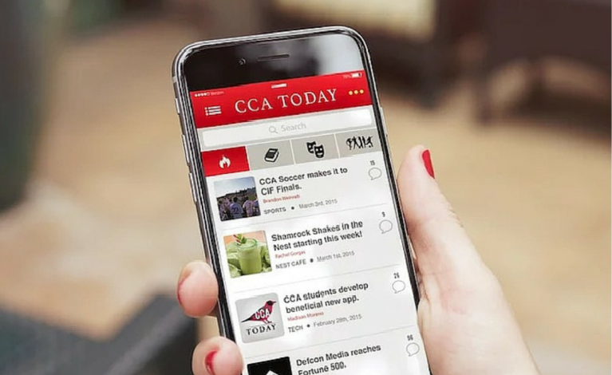
Product Inspiration
CCA TODAY APP
JA USA
This California based JA Company created an interactive app available through both Apple and Google Play stores. The app was designed for schools to track internal and external events and news for students.
Notes:
Overview of Company Program (15 min)
Review the product inspiration slides to highlight successful companies from previous JA Company Program students
As you review the slides, encourage students to take inspiration from these ideas

Slide 16
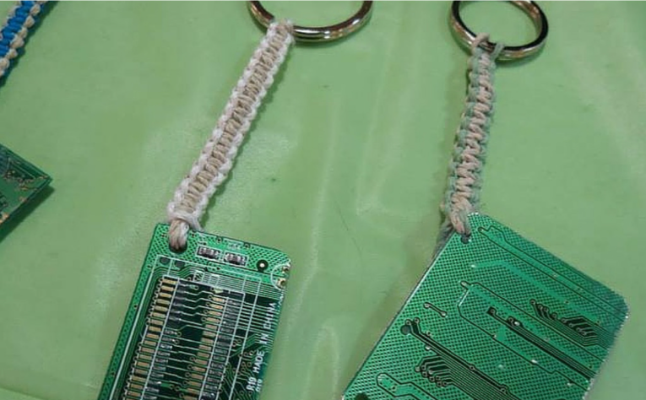
Product Inspiration
HARDWIRE KEY CHAINS
JA MANITOBA
This JA Manitoba company made keychains out of old computer motherboards, giving new life to old materials.
Notes:
Overview of Company Program (15 min)
Review the product inspiration slides to highlight successful companies from previous JA Company Program students
As you review the slides, encourage students to take inspiration from these ideas

Slide 17

Product Inspiration
CARDS REINCARNATE
JA BRITISH COLUMBIA
This company offers hand made and designed greeting cards with detachable seed paper that you can plant and grow into wildflowers to “grow the relationship between giver and receiver.”
Notes:
Overview of Company Program (15 min)
Review the product inspiration slides to highlight successful companies from previous JA Company Program students
As you review the slides, encourage students to take inspiration from these ideas

Slide 18

Success Stories
JA ALUMNI
Mark Cuban – Owner of the Dallas Mavericks.
Donna Shalala – President of the University of Miami and Former Secretary of Health when Bill Clinton was President of the USA.
Bruce Poon Tip – Founder of G Adventures.
Nicholas Kee – JA Jamaica Alumni (founding member of Plastato) now pursuing three different ventures with partnerships made across the Americas.
Notes:
Overview of Company Program (15 min)
Review the success stories slides to highlight JA Alumini and companies whose JA Company program experience helped contribute to their future success
The videos on the following slides can help you learn more about their story.

Slide 19


Success Stories
JA COMPANIES
Promo-bands
A JA Canada Company that continued operations for a time after the program ended. The original student company based in Newmarket, Ontario, sold $20,000 in $2.00 bracelets the summer after Company Program.
Commando
A JA UK Company that had their product features in Vogue magazine after David Beckham was seen wearing it.
Notes:
Overview of Company Program (15 min)
Review the success stories slides to highlight JA Alumini and companies whose JA Company program experience helped contribute to their future success
If you have returning JA participants, this would be a great time to invite them to share their story

Slide 20
PITCHING & BRAINSTORMING

Slide 21

Brainstorming
Write as
Notes:
Brainstorming and Pitching Activity (60 mins)
This is now the time for students to start critical brainstorming. The key thing is to ensure everyone defers judgment of ideas while in the initial process.
Emphasis that constructive criticism should be respectful and positive, and that it can lead to better ideas overall.
There are many approaches that this process can take. You may want to focus on ideas to solve a customer need that is of particular interest to the group, or products and services that would apply to an appealing business model. Or perhaps this is simply a “free for all” to discover what the group will gravitate toward.

Slide 22


Ways to Brainstorm
INDIVIDUALLY
Work by yourself to record as many ideas as possible.
IN GROUPS
Work with a group. Everyone shares their ideas in a fast-paced group discussion. Remember not to judge ideas.
Notes:
Brainstorming and Pitching Activity (60 mins)
Explain to students that there are different ways to brainstorm. Students will participate in three rounds of brainstorming with a short break between each round to explore the different ways brainstorming can be done.
Round 1: Brainstorm individually (10 min)
Round 2: Brainstorm in pairs (10 min)
Round 3: Brainstorm in groups (10 min)

Slide 23

Overcoming Challenges
CHALLENGE
Ideas don’t seem big enough.
OVERCOME IT
Don’t limit yourself to what is real and possible. Small ideas don’t often have the ability to become big ideas without considering the seemingly impossible.
Notes:
Brainstorming and Pitching Activity (60 mins)
Review each of the challenges and strategies for overcoming them.

Slide 24

Bag of Junk & Pitching Activity
Pitches must include:
A clearly stated problem.
A description of the product or service solution.
Who is the audience and/or customer? (target audience)
What benefits will they enjoy?
What will it cost?
Why would a customer choose their product over another (competitive advantage)
What catchy tag line will attract the attention the product deserves?
*Pitches must be 1 minute or less in length.
Notes:
Brainstorming and Pitching Activity (60 mins)
Each team will create a 1-minute pitch to be done in front of the group.
Review the pitch guidelines.
Give each group the opportunity to prepare and practice their pitch before presenting.
Mentors can provide feedback on the product or service ideas as well as pitches.

Slide 25
PRODUCT & SERVICE RESEARCH ASSIGNMENT

Slide 26
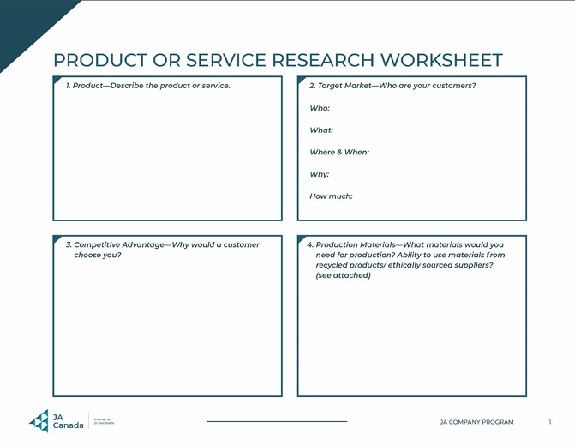
Product & Service Research Assignment
Answer as many of the questions that follow on the provided answer sheet.
This will help you prepare for pitching your idea to your team.
Notes:
Product or Service Research Assignment (15 min)
Let students know that they must continue to brainstorm ideas at home and more time will be allotted to this next week.
Review the Product or Service Research assignment document with the group.
The worksheet will help them work through the viability of some of their ideas. They should spend time completing this prior to the next session.
Pitches will occur in either Week 3 or 4 (based on your Charter’s direction). Students should select only one idea to explore in detail. They may choose to work individually or in groups. However, each student is encouraged to research one idea.
Many students will be eager to understand how their product idea will be considered and selected. This is a good time to review the Product and Service Guidelines found in the JA Canada Welcome Package for Students.
Be sure to establish the expectation that the Product or Service Research Worksheet must be completed if a student wants to be eligible to pitch their idea. Remind students of the importance of ethics when researching suppliers. Also, if the product can have a positive impact through using recycled goods that would be of value to the JA Company.
This worksheet is designed to be a simple way to structure a “Pitch Deck” (slideshow) if students choose to prepare visuals for their pitch.
Students will be e-mailed a copy of the Product and Service Research Assignment or expected to complete in on the collaboration tool used by the charter (ex. Mural)

Slide 27
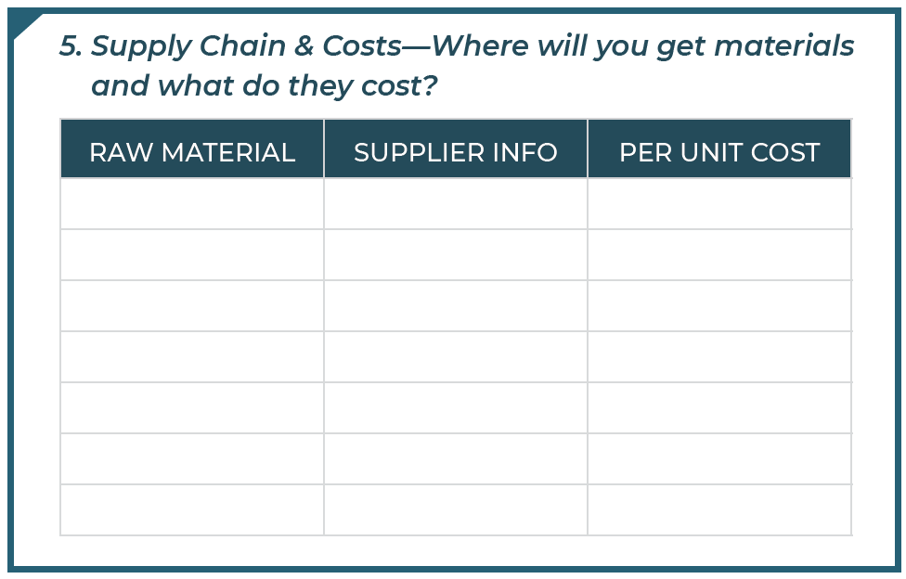

Supply Chain & Costs
Go online to find out the cost of the materials you will need to produce your product or deliver your service.
Call stores that do not have online stores. Shop around!
How much do you think you could sell your product or service for?
Notes:
Product or Service Research Assignment (15 min)
Break down each element in the worksheet. Students should use this as a guide to complete the research for their product ideas/pitches.

Slide 28
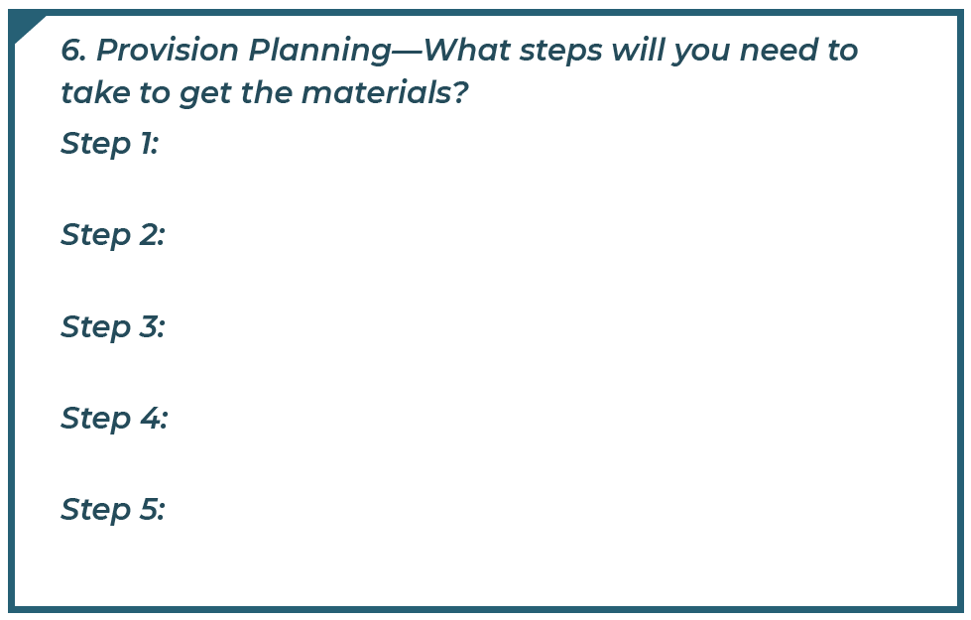

Provision Planning
Are materials easily available?
Are there enough steps in production to involve the whole team?
Are special skills required? Does your team have those skills?
Are there licenses or certificates needed to provide this product?
Are there any issues with availability of materials for this product?
If you plan to order online, what is the delivery time?
Notes:
Product or Service Research Assignment (15 min)
Break down each element in the worksheet. Students should use this as a guide to complete the research for their product ideas/pitches.

Slide 29
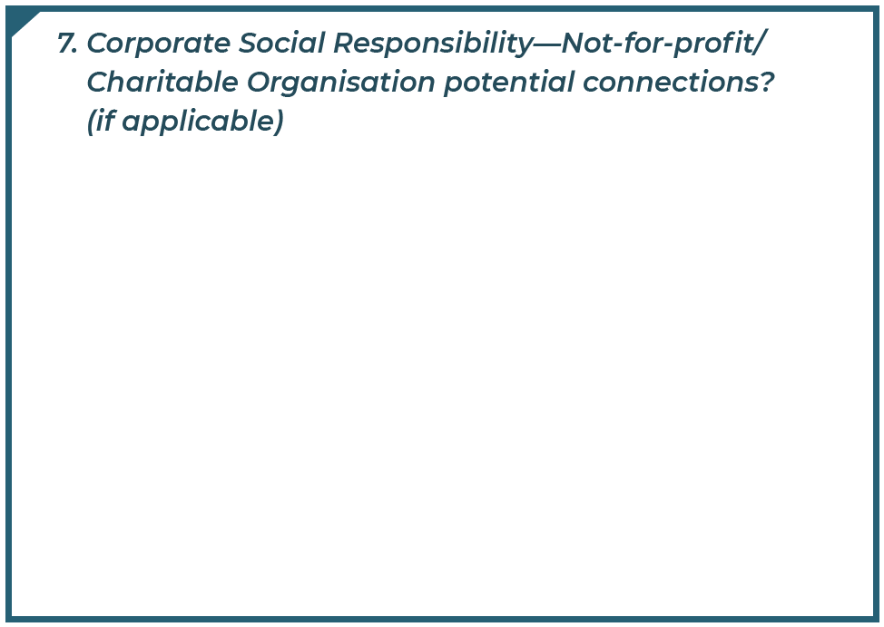

Corporate Social Responsibility
How can your company have a positive impact?
Are there other organizations that you could support to maximize your company’s positive impact?
Notes:
Product or Service Research Assignment (15 min)
Break down each element in the worksheet. Students should use this as a guide to complete the research for their product ideas/pitches.

Slide 30
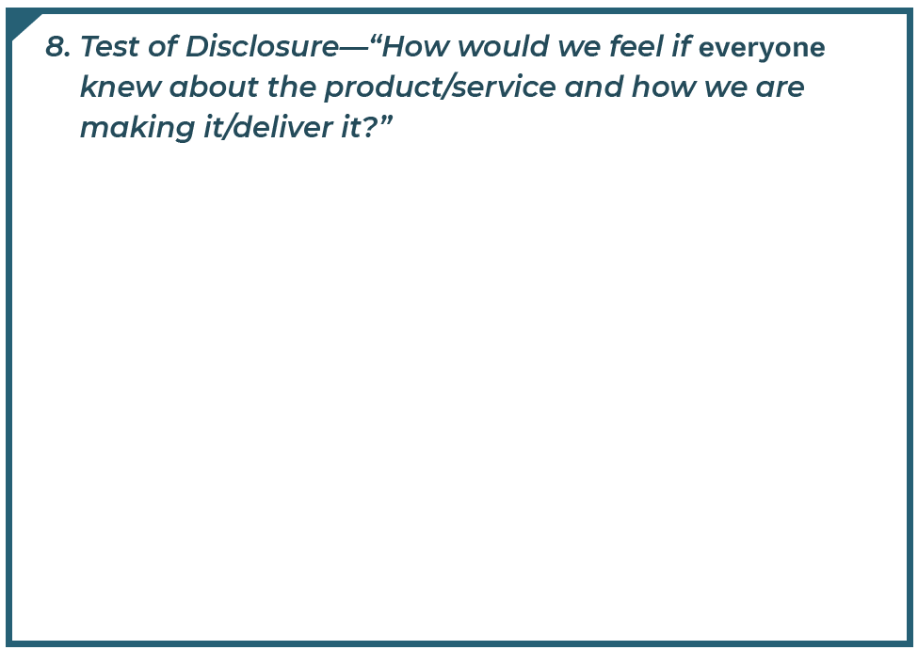

Test of Disclosure
Consider the JA Company Program Code of Ethics.
Use the Test of Disclosure.
Notes:
Product or Service Research Assignment (15 min)
Break down each element in the worksheet. Students should use this as a guide to complete the research for their product ideas/pitches.

Slide 31

Get Ready to Pitch!
PREPARE YOUR PITCH!
You will have maximum of two minutes to pitch your product or service idea.
Your Product or Service Research answer sheet should be used to create a six slide “Pitch Deck”.
You must hand in the answer sheet or a printed “Pitch Deck” to be eligible to share your idea.
Be creative! Have a prototype if possible.
Your peers will be evaluating pitches. Mentors will tally up scores to determine the top product or service.
Notes:
Product or Service Research Assignment (15 min)
Many students will be eager to understand how their product idea will be considered and selected. This is a good time to review the Product and Service Guidelines
Let students know they are expected to complete the Product or Service Research Worksheet to be eligible to pitch their idea.
Remind students of the importance of ethics when researching suppliers. Also, if the product can have a positive impact through using recycled goods that would be of value to the JA Company.
This worksheet is designed to be a simple way to structure a “Pitch Deck” (slideshow) if students choose to prepare visuals for their pitch.

Slide 32

What Makes a Great Pitch?
A clear description of the product or service
Target market and competitive advantage
Approximate production or set-up costs
Suggested selling price and estimated breakeven number
Fun tag line to promote the product or service
Notes:
Product or Service Research Assignment (15 min)
Review the elements of a great pitch.
Invite students to ask any questions they may have about the assignment or their pitch.

Slide 33
PRODUCT & SERVICE GUIDELINES

Slide 34


Product and Service Guidelines
The product or service should:
The product or service should not:
Fill a need or perceived need.
Be something customers are willing to pay for.
Be something that Company members are passionate about.
Be able to generate revenue.
Include food or cosmetic items of any kind.
Be event-based.
Misrepresent JA values or beliefs in any way.
Be offensive to the general public including, but not limited to, racial, gender, sexual or religious sensitivities.
Notes:
Review the general product and service guidelines on the slide and share the full product and service guidelines from your local Charter.
Advisor tip: Students can look into the UN Sustainable Development Goals if they are stuck finding a direction to brainstorm needs to fill.

Slide 35
ENTREPRENEURIAL RESILIENCY MODULES

Slide 36
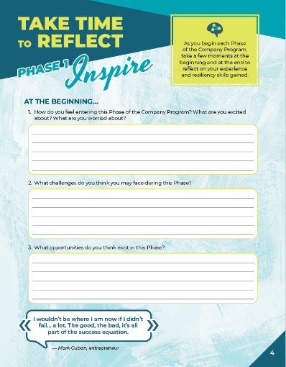
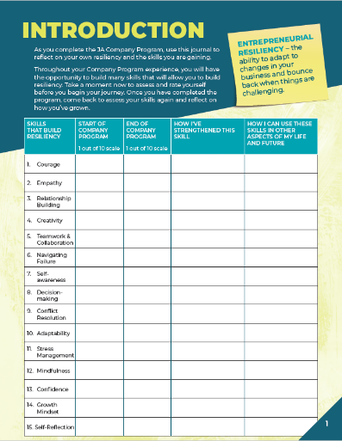

Company Program Resiliency Modules
Entrepreneurial resiliency is the ability to adapt to changes in your business and bounce back when things are challenging.
As you complete the JA Company Program, use this journal to reflect on your own resiliency and the skills you are gaining.
Notes:
Company Program Resiliency Modules (10 min)
Using the Company Program Resiliency Modules advisor guide, follow the instructions to guide students through the activities and discussions for Phase 1.
If time allows, have students complete the self-assessment on page 1 during the meeting, or independently before the next meeting.

Slide 37
QUESTIONS & WRAP UP

Slide 38



Questions & Next Steps
QUESTIONS?
NEXT STEPS
Complete/return all forms
Begin the Product or Service Research Assignment
Complete the What’s Your Leadership Style? Quiz on JA Campus before the next session.
Notes:
Wrap-Up (10 min)
Create an opening for students to ask any questions about the meeting prior to wrapping up.
If you identify any returning students, please have them speak briefly about why they are doing the program again and its impact on their life. This should help with getting students to return the second week.
Review the next steps with students:
Remind students to bring all forms, to the next meeting if they did not have them with them already.
Let students know that next week you will continue brainstorming and research. They will also have the opportunity to learn about the many company roles and nominate themselves and others.
Instruct students to begin the product or service research assignment
Direct students to the JA Campus, so they can complete a two-minute Assessment: What’s Your Leadership Style? in advance of next session.
(https://hbr.org/2015/06/assessment-whats-your-leadership-style)
Encourage students to access the JA Campus to review some of what was covered in this meeting.
Conclude the session by reminding participants that entrepreneurs can start businesses on their own or as part of a small group by combining individual strengths and sharing responsibilities. Today is the start of something great!
Advisors:
Gather attendance records
Take a few moments to debrief about the first session with the team of Advisors
If you were not able to cover any material, make a note and move it to your next meeting
Address any questions, concerns or feedback to your Company Program Manager
Congratulations on completing your first meeting!

